Slide 1
ABP Estimation Pipeline
SARANSH GUPTA

Slide 2
INTRODUCTION
Arterial blood pressure (ABP) is the pressure of the blood against the walls of the arteries. It is measured in two numbers: systolic blood pressure (SBP) and diastolic blood pressure (DBP). SBP is the pressure when the heart beats, and DBP is the pressure between heartbeats.
The ABP pattern estimation pipeline is a noninvasive method for ABP measurement. It uses photoplethysmography (PPG) and electrocardiogram (ECG) signals to estimate the ABP waveform. PPG is a technique that measures changes in blood volume in the tissue bed. ECG is a technique that measures the electrical activity of the heart.

Slide 3
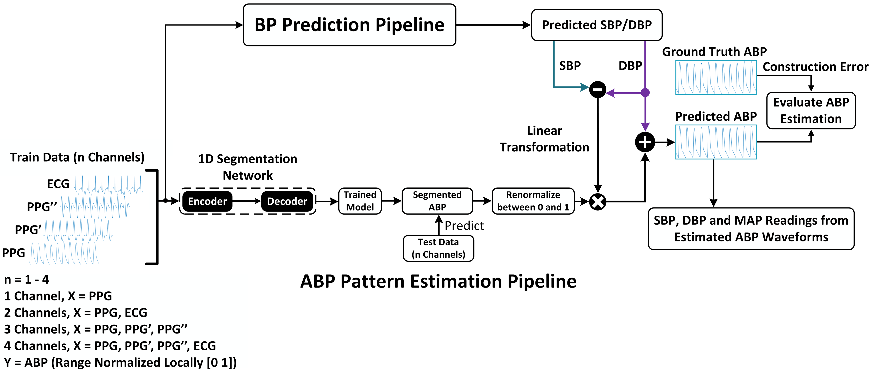
ABP PREDICTION PIPELINE

Slide 4
Main Pipeline Step’s
BP Prediction Pipelines : This step predicts the systolic blood pressure (SBP) and diastolic blood pressure (DBP) values from the PPG and ECG signals.
ABP Prediction Estimation Pipelines : This step takes the predicted SBP and DBP values and combines them with the PPG signals to estimate the complete ABP waveform.

Slide 5
BP Prediction Pipeline
The BP prediction pipeline uses a 1D segmentation network to predict the SBP and DBP values. The network first normalizes the PPG and ECG signals to a range of 0 to 1. Then, the network decelerates the PPG signal twice to capture different frequency components of the original signal. These three signals (PPG, PPG', and PPG") are then concatenated and fed into an encoder-decoder architecture. The encoder extracts relevant features from the concatenated signal, and the decoder reconstructs the original signal. The reconstructed signal is then passed through a linear transformation to predict the SBP and DBP values.

Slide 6
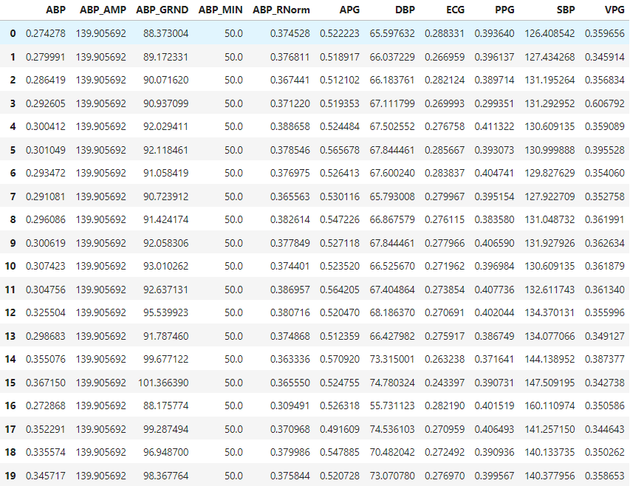
DATASET’S CRUX

Slide 7
ABP Prediction Pipeline
The The ABP pattern estimation pipeline takes the predicted SBP and DBP values and combines them with the PPG signals to estimate the complete ABP waveform. This is achieved by utilizing a nested attention-guided bi-directional convolutional long short-term memory (BiConvLSTM) network. The network first segments the PPG signals into segments corresponding to the systolic, diastolic, and mean arterial pressure (MAP) phases of the ABP waveform. Then, the network uses attention mechanisms to focus on the most relevant parts of the segmented PPG signals for each phase. Finally, the network reconstructs the entire ABP waveform from the segmented and attended PPG signals.

Slide 8
ABP Prediction Pipeline
The ABP pattern estimation pipeline is designed to be robust to noise and interference in the PPG and ECG signals. It can effectively utilize multiple channels of data, including PPG, PPG', PPG", and ECG, to provide more accurate ABP estimations.
Overall, the ABP pattern estimation pipeline provides a comprehensive approach to estimating ABP waveforms from noninvasive PPG and ECG signals. It combines advanced machine learning techniques with physiological knowledge to reconstruct the complex ABP waveform and provide insights into the cardiovascular system's functioning.

Slide 9
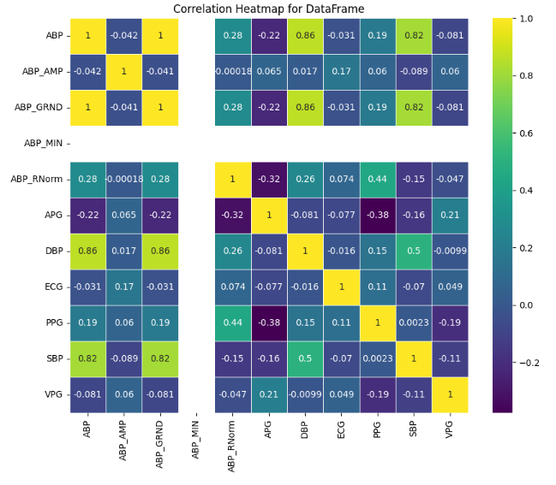
CORRELATION MATRIX

Slide 10
BiConvLSTM Layers
The BiConvLSTM layers extract features from the segmented PPG signals and combine them with information from the attention mechanisms. The BiConvLSTM layers are able to capture long-range dependencies in the data, which is important for accurately estimating the ABP waveform.
Attention Mechanism
The attention mechanisms focus on the most relevant parts of the segmented PPG signals for each phase of the ABP waveform. This helps to improve the accuracy of the ABP estimation.

Slide 11
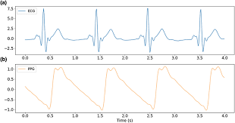
1D Segmentation Result

Slide 12
Reconstruction Layer
The reconstruction layer reconstructs the entire ABP waveform from the segmented and attended PPG signals. The reconstruction layer uses a combination of convolutional and upsampling layers to increase the resolution of the reconstructed signal.
Training & Evaluation
The deep learning model is trained on a dataset of PPG and ECG signals paired with corresponding ABP waveforms. The model is trained using a supervised learning algorithm, which aims to minimize the error between the predicted ABP waveform and the true ABP waveform.
The performance of the deep learning model is evaluated on a held-out test set. The model is evaluated on its ability to accurately predict the SBP, DBP, and mean arterial pressure (MAP).

Slide 13
Conclusion
The deep learning model used in the ABP pattern estimation pipeline is an effective way to estimate ABP waveforms from noninvasive PPG and ECG signals. The model is robust to noise and interference in the PPG and ECG signals and can effectively utilize multiple channels of data to provide more accurate ABP estimations.

Slide 14
THANK YOU
SARANSH GUPTA AIML DEVELOPMENT INTERN

